Slide 1
Cosmic Dawn &
The Square Kilometer Array
Jonathan Pritchard @jr_pritchard

Slide 2
Notes:
Cosmic dark ages. Before there were stars.

Slide 3
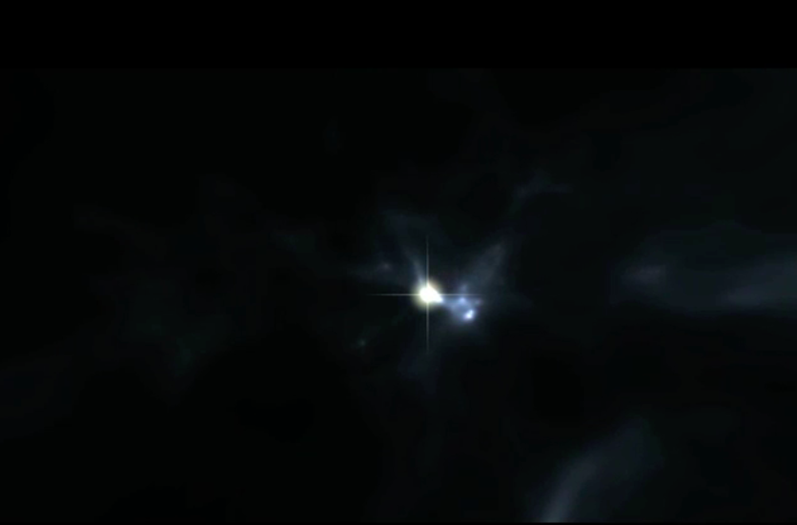
First stars
Abel, Alvarez, Khaesler (Stanford)

Slide 4
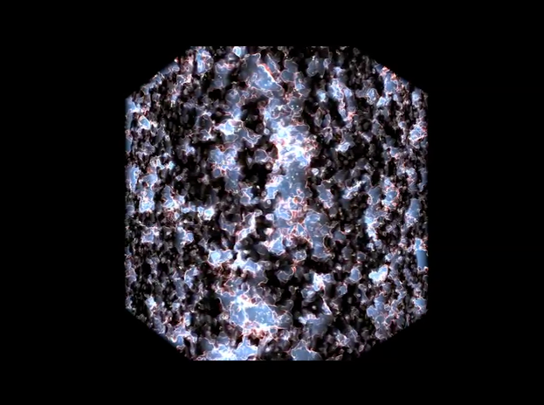
Cosmic Dawn

Slide 5
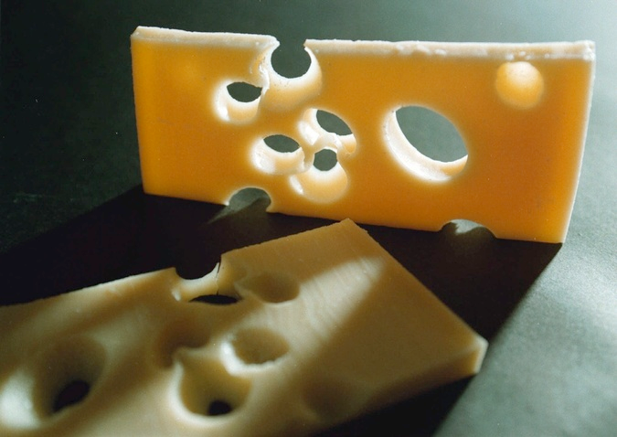
750
million
years
500
million
years
Notes:
Well matured cosmic swiss-cheese.

Slide 6
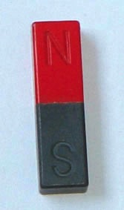


Magnets!
Excited hydrogen
Relaxed hydrogen

Slide 7
Radio 101.2 FM playing songs from the early hundred millions
Notes:
FM radio. Tune into to cheesy music at 10? MHz. Underneath that is signal from cosmic cheese. But a radio astronomer wants a bigger telescope

Slide 8
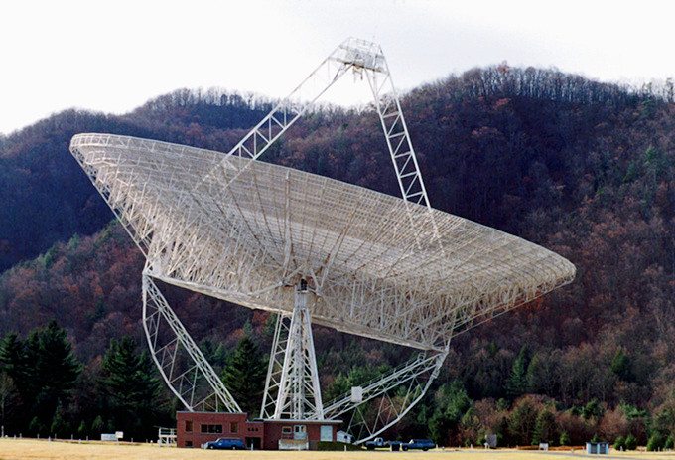
Bigger is better!
Green Bank 300ft telescope
Notes:
Classic radio telescope. Bigger is better.

Slide 9
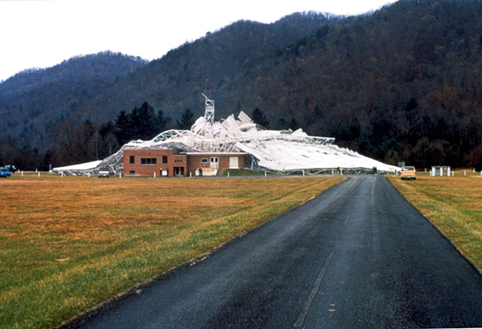
Bad day in West Virginia
collapsed in 15 November 1988 - structural failure
Notes:
Until it does this.
Anyway, dishes are so 20th century. A 21st century telescope looks like this…

Slide 10
Modern Radio Telescope
ALMA correlator 17 Petaflops
Notes:
Modern radio telescope is just a super computer with a peripheral often called a telescope.
Dish does complicated mathematical transform on light, which can mimic with a supercomputer. And then you don’t need the dish.

Slide 11
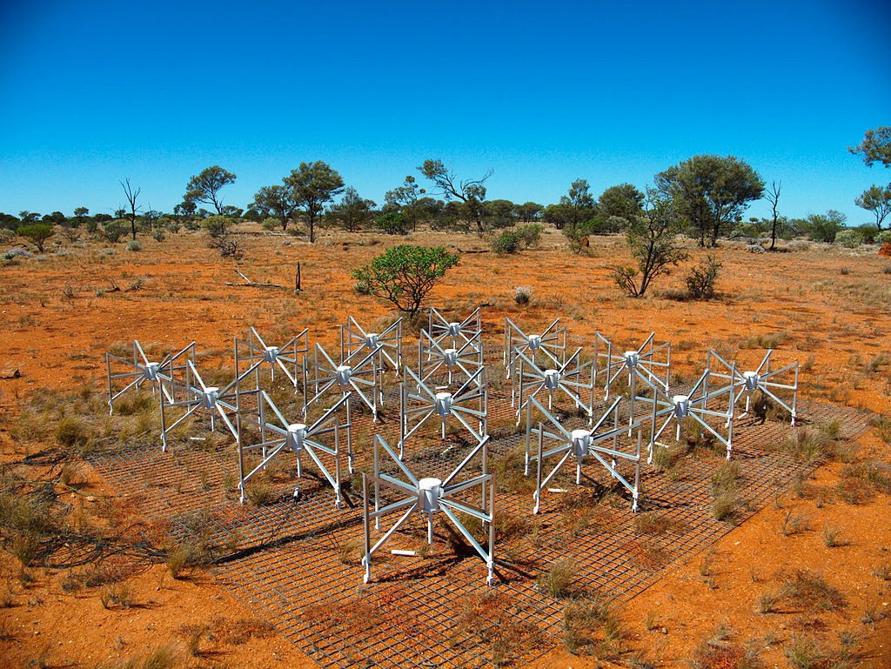
Murchison Widefield Array, Western Australia
Notes:
Murchison shire: Population 113; size 41,000km^2 (twice size of Wales)
Taken by Natasha.
Just a bunch of FM radio antennae.

Slide 12
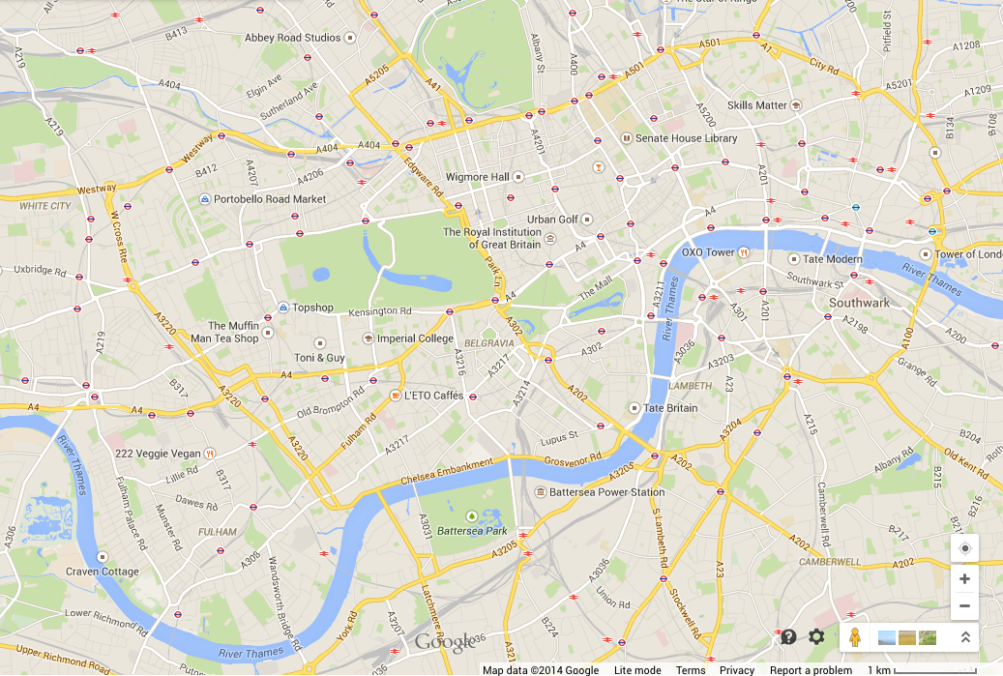
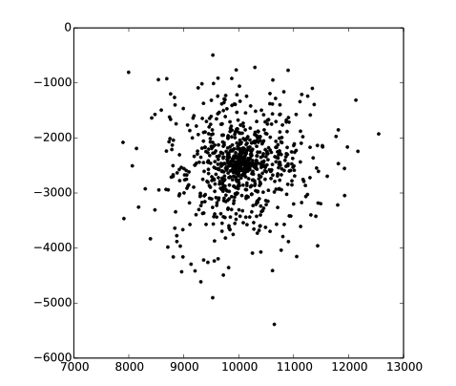
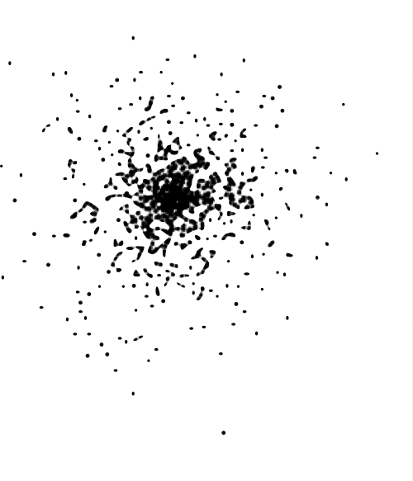
Square Kilometer Array
6 km
890 stations
Square kilometre of collecting area
Completion
~2020
6 km
Notes:
Take 7000 of those and scatter them over the Australian outback.
Spread over 6km radius.
Tendancy to see patterns and join the dots

Slide 13
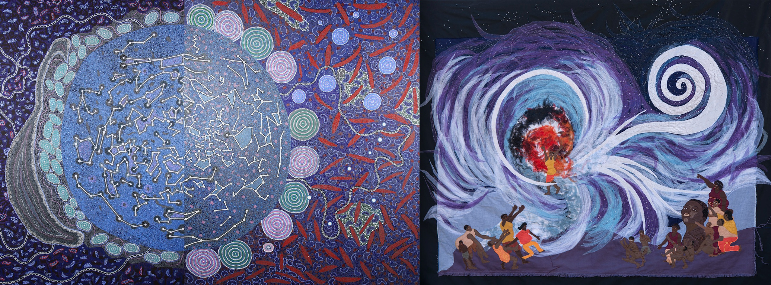
skatelescope.org/shared-sky collaborative painting from Aboriginal Yamaji Artists
Notes:
Even in empty spaces, the land has its stories. Outback has song lines.
Australian and South African people share the same skies.
Two deserts, two peoples, one shared sky.

Slide 14
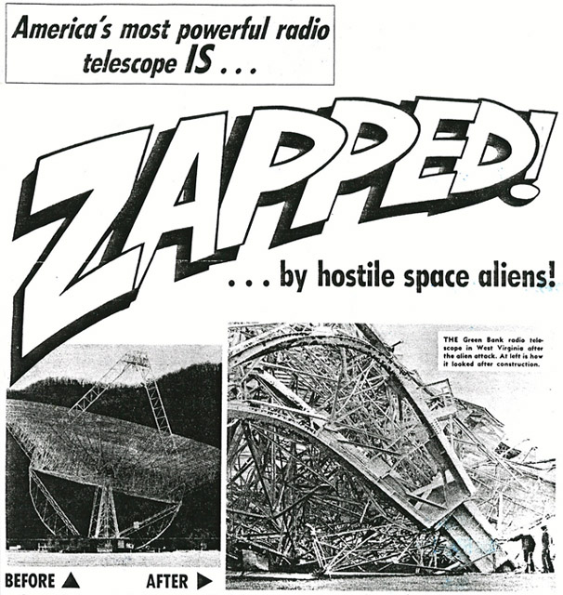

Slide 15
Fin
Notes:
When scientists tell you they want to build a giant FM radio to listen to cosmic cheese. Its not their bad music taste its their enthusiasm to learn about the first stars and galaxies.

